Slide 1
ITERATION 2 METRICS

Slide 2
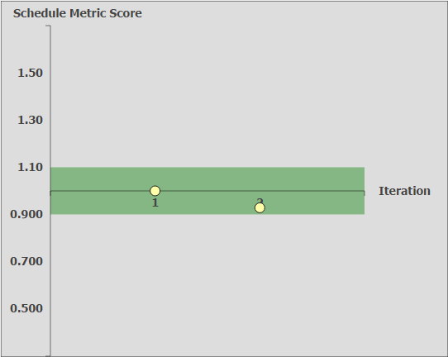
Schedule Metrics

Slide 3
Schedule Metrics
Iteration | Estimated Days | Actual Days | Schedule Metric Index | What can be improved
1 | 4 | 4 | 1.00 | -
2 | 13 | 14 | 0.93 | Allocate debugging time after deployment

Slide 4
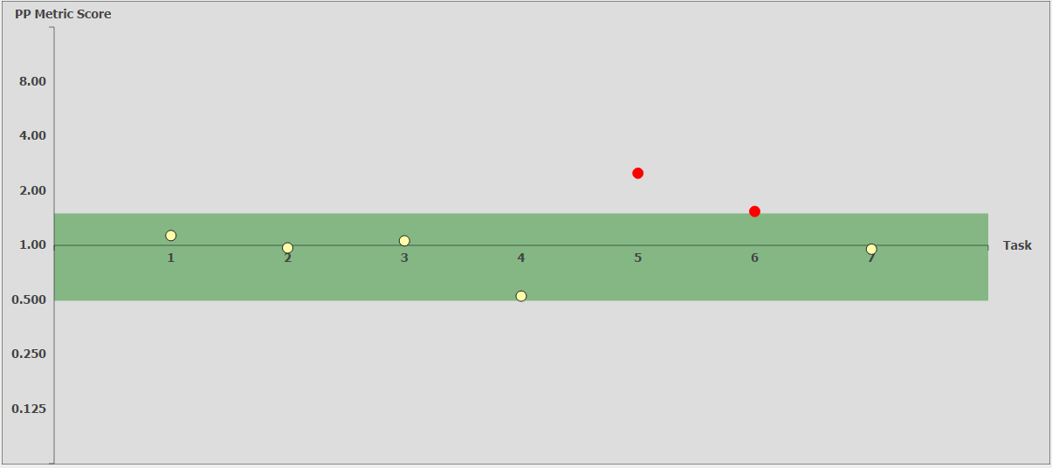
Pair Programming Metrics

Slide 5
Pair Programming Metrics
Functionality | Coders | Estimated Hours | Actual Hours | PP Index | What we can Improve
UI for Login/Logout and Bootstrap | Eva & Yuxuan | 2.0 | 1.8 | 1.13
Login/Logout | Eva & Yuxuan | 5.0 | 5.2 | 0.97
Code Bootstrap (Unzip, Read data files and create SQL tables) | Wu Di & Max | 6.0 | 5.7 | 1.06
Code Bootstrap (Validate data files, connect to database, insert into tables, drop tables) | Wu Di & Max | 6.0 | 11.4 | 0.52
Integrate functionalities | Wu Di & Max | 2.0 | 0.8 | 2.50
Debugging Bootstrap | Wu Di & Max | 6.0 | 6.3 | 0.95
Debugging Login/Logout | Eva & Yuxuan | 3.0 | 2.0 | 1.54

Slide 6
Pair Programming Metrics
Functionality | Coders | Estimated Hours | Actual Hours | PP Index | What we can Improve
UI for Login/Logout and Bootstrap | Eva & Yuxuan | 2.0 | 1.8 | 1.13
Login/Logout | Eva & Yuxuan | 5.0 | 5.2 | 0.97
Code Bootstrap (Unzip, Read data files and create SQL tables) | Wu Di & Max | 6.0 | 5.7 | 1.06
Code Bootstrap (Validate data files, connect to database, insert into tables, drop tables) | Wu Di & Max | 6.0 | 11.4 | 0.52
Integrate functionalities | Wu Di & Max | 2.0 | 0.8 | 2.50 | Estimate Integration time better. (Lower)
Debugging Bootstrap | Wu Di & Max | 6.0 | 6.3 | 0.95
Debugging Login/Logout | Eva & Yuxuan | 3.0 | 2.0 | 1.54 | Allocate debugging time better according to difficulty of functionality

Slide 7
Bug Metrics
Functionality | Bug Details | Category
Login/Logout | Separate User and Admin Login pages. Need to Integrate them. | Low Impact (1 point)
Bootstrap | Takes longer than 15 minutes to upload and validate data | High Impact (5 points)
Overall Score = 6 < 10
Therefore, Errors should be debugged in planned debugging time

